Slide 1
Cavity Detection
Yashwanth
Ravi kiran
Dinesh Chowdary

Slide 2
TABLE OF CONTENTS
01
02
03
04
05
06
Introduction
Objectives
Dataset
Sgd’s
Outcomes
Gaps Identified through
Literarure survey

Slide 3

INTRODUCTION
The most common disease in the world is dental caries, also referred to as dental cavities. Practically everyone had at least one encounter with this pathology.
Unfortunately, millions of people are unable to access dental treatment due to obstacles like
dentophobia,
a shortage of dentists,
and a lack of dental insurance.

Slide 4

Objectives
Identify dental caries at the earliest possible stage to prevent further progression and minimize the need for invasive treatments such as fillings or root canals. Early detection can help preserve more of the natural tooth structure and improve long-term oral health outcomes.
Experiment with model hyper parameters, architectures, and training strategies to optimize the performance of the cavity detection models. Explore techniques such as data augmentation, transfer learning, and ensemble methods to improve robustness and generalization.

Slide 5

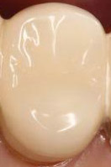
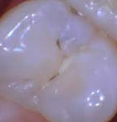
DataSet
Sample1
Sample 2
The compiled Dataset consist of 500 images taken from various sources
No of classes:
No Cavity
Early Stage
Moderate Stage
Severe Stage
Dataset link:dental_dataset.zip - Google Drive
And kaggle.

Slide 6



SDG’S

Slide 7

Gaps Identified through Literature Survey
Dependency on Image Quality: The performance of cavity detection models is highly dependent on the quality and resolution of the input dental images
Limited Generalization: Many cavity detection models are trained on datasets collected from specific populations or dental settings, which may limit their generalization to diverse patient demographics, dental conditions, or imaging modalities.
Limited Data Availability: Access to large-scale, annotated datasets for cavity detection is often limited due to privacy concerns, data sharing restrictions, and the labor-intensive nature of manual annotation by dental experts.

Slide 8

Outcomes
Research Paper
Working Prototype

Slide 9
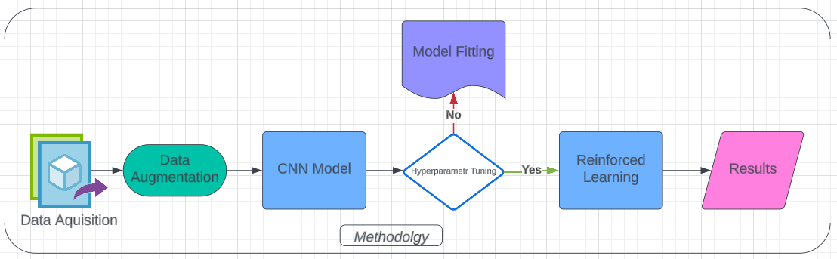
Methodology

Slide 10
THANKS!

